Slide 1
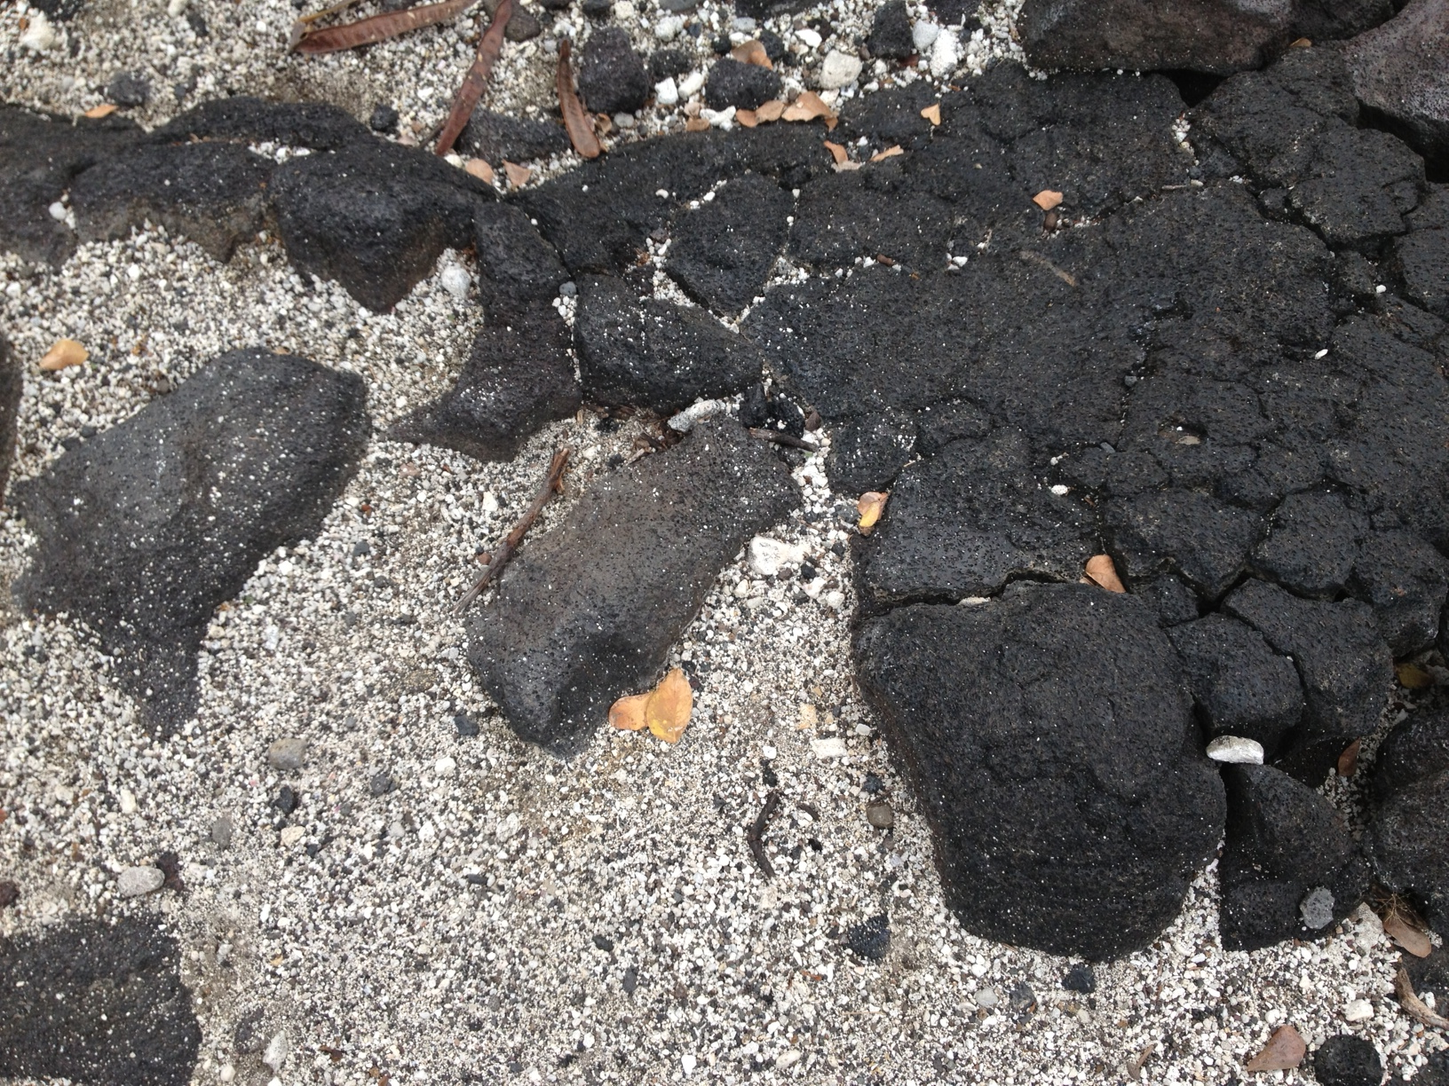
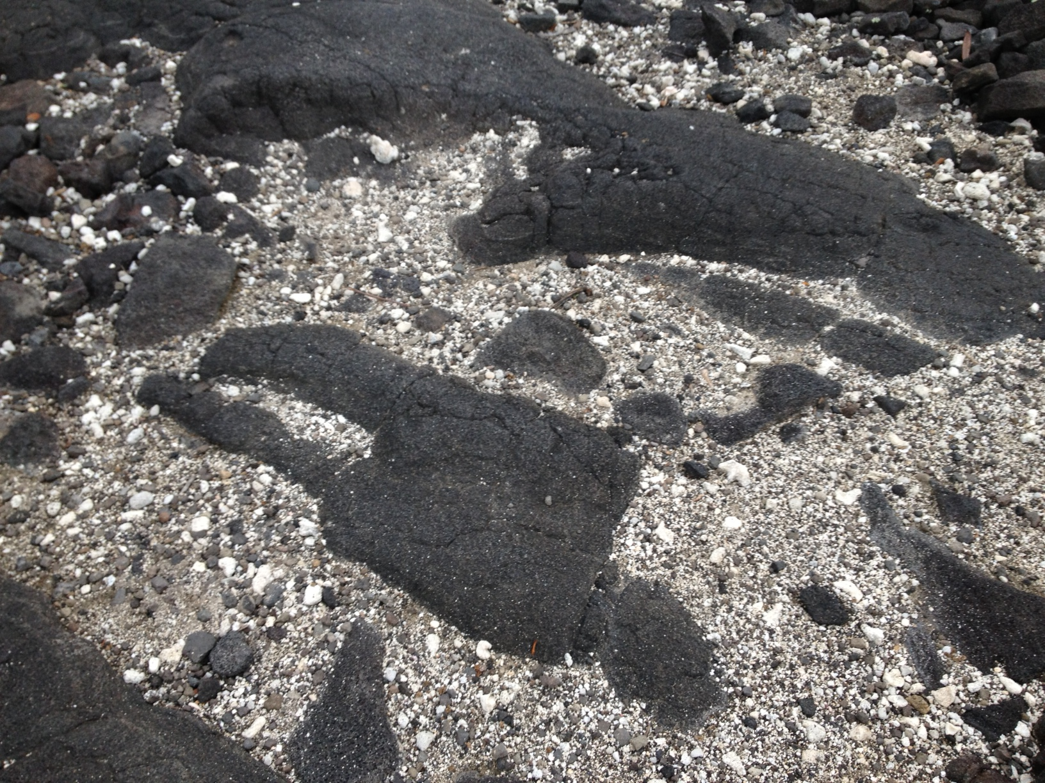
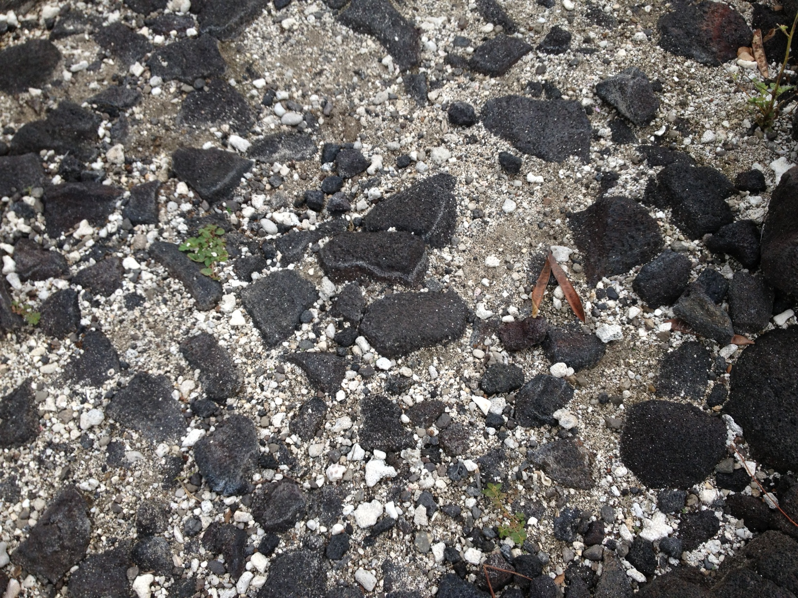
Rocks – Three Topographies
(a)
(b)
(c)
Illustration of three naturally-occurring topographies, observed within several yards of each other on the 1871 Trail in the Pu’uhonua o Hōnaunau National Historical Park near Captain Cook, on the Big Island of Hawai’i: (a) Larger lava rocks surrounded by white coral sand, where all lava rock elements are connected with each other. (b) A more fragmented version, in which various distinct sizes of lava rocks appear, yielding a range of lava rock sizes and varied degrees of connectiveness. (c) A yet more granular version of the same, with coral fragments approaching the size of some of the lava pebbles. Photos by A.J. Maren, 2020.
Figure from: Rocks-three-topographies_overlay_2021-04-13.pptx; in:
AJM – Research Papers – LaTeX / AJM Figures and Photos / Orig Photos – Rocks
AJM – Research / 2D CVM Variational Bayes / Rock Topographies

Slide 2
Detailed View: Rocks – Three Topographies
(a)
(b)
(c)

Slide 3
Grid Overlay to Create the Representation r from the Initial System Psi
An 8x8 2-D CVM Grid Overlay
This overlay grid was applied to a central area of each of the three rock topographies selected for this demonstration.
A wrap-around of four nodes in both vertical directions, with node activations the mirror image of those in the corresponding position in the central area, was used to create the initial 8x16 representation. The wrap-around was then extended in both horizontal directions to create the full 16x16 representation.
Figure from: Rocks-three-topographies_overlay_2021-04-13.pptx; in:
AJM – Research Papers – LaTeX / AJM Figures and Photos / Orig Photos – Rocks
AJM – Research / 2D CVM Variational Bayes / Rock Topographies

Slide 4
An 8x8 2-D CVM Grid Overlay

Slide 5
Data Preparation to Create the Representation r from the Initial System Psi
Step 1. Image Selection
Three images were selected from an initial set of seven image of natural rock topographies (lava rock and coral sand). These were chosen because:
They exhibited different topographic types, from highly-connected (large masses of lava rock) to relatively granular, so that there was likely a range of configuration variables in these three different topographies, and
They provided approximately equal numbers of dark (lava) and light (coral sand) areas.

Slide 6
Data Preparation to Create the Representation r from the Initial System Psi
Step 2. Apply Grid Overlay
The 8x8 grid overlay was applied to a central area in each of the three images. For each node within the 8x8 grid, the black-or-white bistate determination was made via visual inspection. Some nodes, that could be either-or, were established as “grey,” and black or white values were assigned later in order to ensure equiprobable numbers of black and white nodes.
The grid size was kept to 8x8 so that the visual inspection could be accomplished and “grey” nodes assigned as needed.
In some cases, two or more grid overlays (placed congruent to each other) were used to obtain a sufficiently rich and diverse topography, as well as greater likelihood of black/white equiprobability.
Of the initial images selected, the first did not have sufficiently equal numbers of dark and light areas once the grid overlay was applied; the grid had to be moved to a different location in the image.

Slide 7
Data Preparation to Create the Representation r from the Initial System Psi
Step 3. Extend the natural pattern via a mirror image reproduction of existing nodes
Once the grid overlay was placed so that an equal number of both black and white nodes was obtained, the second concern was avoiding an abrupt change in the nature of configuration variables when the “wrap-around envelope” was created.
When two vertically-arranged grids were used to obtain the initial set of nodes, the only means of avoiding introduction of anomalous vertically-oriented configuration variables was to place the grid so that the node types (black or white) were approximately the same at the top and the bottom of the grids. This was not always possible, so some anomalies were introduced.
However, to minimize anomalies caused by juxtaposing nearly all-black versus all-white areas on the horizontal wrap-arounds, a mirror image of the nodes was created at the vertical borders. The mirror image width was equal to half the grid size; e.g., four units each on the left and right when an 8x8 grid was used.

Slide 8
Data Preparation to Create the Representation r from the Initial System Psi
Step 4. Enter the grid representation as “0” and “1” units in the 2D CVM program designed to work with defined representations.
The program will compute the wrap-arounds.
It will be appropriate to run the program with some starting h-value range. These values are not important at this point; we’re looking just for the configuration variables associated with the initial representation.
Step 5. Run the program to obtain the configuration variables associated with the grid representation of the corresponding natural topography.
This yielded values for all the configuration variables. We used y₂, z₁, and z₃.
Step 6: Plot the locations of the configuration variables y₂, z₁, and z₃ on the graph of the analytic solution of configuration variables against different h-values. (This analytic solution holds only when there are equal numbers of black and white nodes.)
Step 7: Visually estimate a range of potential h-values that might conceivably yield topographies that would be considered “best matches” to the initial natural topography.
This range of h-values will be used to run the program again, stepwise, through the various h-values and to obtain resulting free energy-minimized topographies, with their configuration values.

Slide 9
Natural Topography #1: Most cohesive blocks of white and black nodes
Trials:
Overlay attempt #1:
- First grid overlay of two vertical adjacently-placed grids was aborted (not enough black nodes; 57 out of 64 needed)
Overlay attempt #2:
- Same grid overlay pattern; shifted one unit to the right - this provided a useful representation.

Slide 10
rocks-2_2020-11-16.jpg
Trial 1:
This pattern was used to provide the “most connected” topography.

Slide 11
rocks-2_2020-11-16.jpg
Natural Topography #1
Grid Overlay Attempt #1:
Using two of the 8x8 grid overlays to create an 8x16 vertical grid
Using two vertical adjacently-placed overlay grids gave close to equal numbers of black and white nodes, but not quite close enough.
Total of 2x8x8 or 1248 nodes

Slide 12

Row 15*
*wrap-around
Natural Topography #1: Highest Cohesion
Numbers of Black Nodes
(Central Columns)
Natural Topography #1
Using two of the 8x8 grid overlays to create an 8x16 vertical grid
Aborting this pattern version
Row 0
Row 0: 2 (1,1)
Row 1
Row 1: 4 (1,3)
Row 2
Row 2: 8 (4,4)
Numbers of Black Nodes
Summary:
Row 3
Row 3: 8 (4,4)
Row 4
Row 4: 7 (3,4)
Top Half: 45 (18, 27)
Bottom Half: 12 (6, 6)
Row 5
Row 5: 7 (3,4)
Row 6
Row 6: 4 (1,3)
Row 7
Row 7: 5 (1,4)
Nodes shown in grey could be counted either way – black or white.
Row 8
Row 8: 4 (2,2)
Row 9
Row 9: 5 (3,2)
Row 10
Row 10: 2 (1,1)
Row 11
Row 11: 1 (0,1)
Row 12
Row 12: 0 (0,0)
Row 13
Row 13: 0 (0,0)
Row 14
Row 14: 0 (0,0)
Row 15
Row 15: 0 (0,0)
This blue bar was used to keep track during visual counting of the black and white units.

Slide 13
rocks-2_2020-11-16.jpg
Natural Topography #1
Using two of the 8x8 grid overlays to create an 8x16 vertical grid
Vertical grids shifted one unit to the right, compared with first (aborted) grid layout

Slide 14
Natural Topography #1
Grid Overlay Attempt #2:
Using two of the 8x8 grid overlays to create an 8x16 vertical grid
Shifted both grids one unit to the right; still keeping centered in the grid pattern
Row 15*
*wrap-around
Natural Topography #1: Highest Cohesion
Numbers of Black Nodes
(Central Columns)
Row 0
Row 0: 2 (1,1)
Row 1
Row 1: 5 (2,3)
Row 2
Row 2: 7 (3,4)
Numbers of Black Nodes
Summary:
Row 3
Row 3: 8 (4,4)
Row 4
Row 4: 7 (3,4)
Row 5
Row 5: 8 (4,4)
Top Half: 46 (21, 25)
Bottom Half: 18 (7, 11)
Row 6
Row 6: 4 (1,3)
Row 7
Row 7: 5 (3,2)
Row 8
Row 8: 5 (3,2)
Row 9
Row 9: 5 (3,2)
Row 10
Row 10: 3 (1,2)
Row 11
Row 11: 2 (0,2)
Row 12
Row 12: 1 (0,1)
Row 13
Row 13: 2 (0,2)
Row 14
Row 14: 0 (0,0)
Row 15
Row 15: 0 (0,0)

Slide 15
Natural Topography #1
Grid Overlay Attempt #2:
Using two of the 8x8 grid overlays to create an 8x16 vertical grid
Shifted both grids one unit to the right; still keeping centered in the grid pattern
Row 15*
*wrap-around
Natural Topography #1: Highest Cohesion
Numbers of Black Nodes
(Central Columns)
Row 0
Row 0: 2 (1,1) x 2
Row 1
Row 1: 5 (2,3) x 2
Row 2
Row 2: 7 (3,4) x 2
Numbers of Black Nodes
Summary:
Row 3
Row 3: 8 (4,4) x 2
Row 4
Row 4: 7 (3,4) x 2
Row 5
Row 5: 8 (4,4) x 2
Top Half: 46 (21, 25) x 2
Bottom Half: 18 (7, 11) x 2
Row 6
Row 6: 4 (1,3) x 2
Row 7
Row 7: 5 (3,2) x 2
Row 8
Row 8: 5 (3,2) x 2
Mirror image node activations created on the right and left sides; 4 nodes wide on each side.
Row 9
Row 9: 5 (3,2) x 2
Row 10
Row 10: 3 (1,2) x 2
Row 11
Row 11: 2 (0,2) x 2
Row 12
Row 12: 1 (0,1) x 2
Row 13
Row 13: 2 (0,2) x 2
Row 14
Row 14: 0 (0,0) x 2
Row 15
Row 15: 0 (0,0) x 2

Slide 16
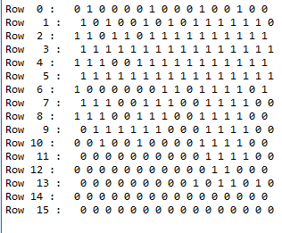
Row 15*
*wrap-around
Natural Topography #1: Highest Cohesion
Node Activations Entered into Program
Row 0
Row 1
Row 2
Row 3
Row 4
Row 5
Row 6
Row 7
Row 8
Row 9
Row 10
Row 11
Row 12
Row 13
Row 14
Row 15

Slide 17
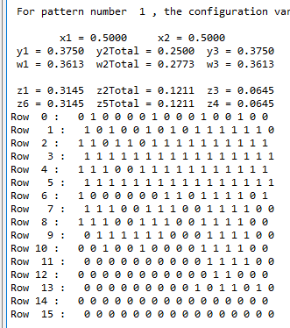
Natural Topography #1
Results from Using the Program to Compute the Configuration Variables:
2D-CVM-def-pttrns_anlytc-FE-vary-e1-v1pt5_2021-04-08.py
Used Pattern 1 for this trial.
z1: 0.3145
z3: 0.0645
y2: 0.250/2 = 0.125

Slide 18
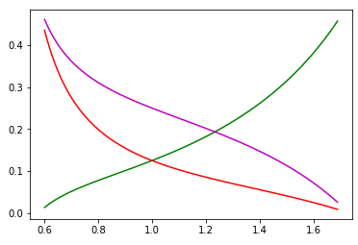
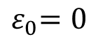
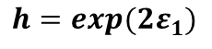
We Can Obtain Analytic Results for Certain Cases
Natural Topography #1
Analytic Values for Configuration Variables y₂, z₁, and z₃
Case where activation enthalpy : x₁ = x₂ = 0.5
$${ ε}_{0}=0$$
B
A
A
y₂
Z₃:
Z₁:
y₂:
B
B
A
A
A
A
A
z₁
y₂
z₁
z₃
Configuration variable
h = 1 (ε₁ = 0)
Nat. Top. #1:
z₃
y₂ = 0.250/2
= 0.125
z₁ = 0.315
z₃ = 0.065
h: interaction enthalpy parameter;
$${ h=exp(2ε}_{1})$$

Slide 19
Configuration Variable Values and Likely h-value Range for Pattern #1
Step 7: Visually estimate a range of potential h-values that might conceivably yield topographies that would be considered “best matches” to the initial natural topography.
This range of h-values will be used to run the program again, stepwise, through the various h-values and to obtain resulting free energy-minimized topographies, with their configuration values.
A reasonable test range for “best” h-values would be 1.45 < h-value < 1.5. (See placement of configuration variable values on analytic graph.)
The configuration variable value z₁ corresponds to an h-value of approximately 1.45, whereas the z₃ value corresponds to an h-value of approximately 1.5. The configuration variable y₂ value is in the middle.

Slide 20
Natural Topography #1:
Initial Interpretations of Configuration Variable Values and Corresponding h-values
Configuration variable z₁: A-A-A triplets (black-black-black): This triplet comes from the solid mass of black nodes on the upper RHS of the pattern. When we did the wrap-arounds, we created a black mass on the right, and a corresponding black mass on the left. The connection between these two areas – which is an artifact compared with the original image – probably slightly increased the z₁ value with regard to the initial topography.
Configuration variable z₃: A-B-A triplets (black-white-black): This value is also a little higher than for the central h-value centered on the y₂ (A-B and B-A pairs) value. High z₃ values are generally created by “rivers” of white (B) nodes in a mass of black, or by “peninsulas” or “connecting diagonals” of black in a sea of white. We see some indication of this in the image; the z₃ value may be indicating an irregular boundary in a topography that is otherwise dominated by large landmasses.
Configuration variable y₂: A-B and B-A pairs (black-white and white-black): This value is in the center of the h-values range, compared with the other two configuration variables. The y₂ value indicates unlike pairs, which means a boundary.
It is worth recalling that we had to position the overlay grid so that there were equal numbers of black and white nodes; this could have influenced the topography selection.

Slide 21
Natural Topography #2: Second-Most cohesive blocks of white and black units
Trials:
This pattern was used.
Pattern #2

Slide 22
rocks-1_2020-11-16.jpg
Work with this image was aborted because it was not possible to obtain a central area with equal numbers of dark and light units, once the grid overlay was placed on the image.

Slide 23
Natural Topography #3: Greatest dispersion of white and black units
Trials:
Pattern #3 for Version (a)
Pattern #4 for Version (b)

Slide 24
Analysis of Nat. Topography #2 Has Not Been Done Yet

Slide 25
Natural Topography #3
Version (a)
rocks-5_2020-11-16.jpg
Version (a) led to non-equilibrium set of configuration variables; in particular, z3 was higher than expected, if y2 and z1 were to be taken as the norms.
One plausible reason is that the wrap-arounds emphasized greater like-near-like values, given that the position of the black nodes in the lower right led to replication of a black mass below and to the right when the larger pattern was created from the initial one.

Slide 26
Natural Topography #3
Version (a)
Trial #3 in Patterns

Slide 27
Row 15*
*wrap-around
Natural Topography #3: High Dispersion
Natural Topography #3
Version (a)
Row 0
Row 1
Row 2
Row 3
Row 4
Row 5
Row 6
Row 7
Row 8
Row 9
Row 10
Row 11
Row 12
Row 13
Row 14
Row 15

Slide 28
Natural Topography #3
Version (a)
Row 15*
*wrap-around
Natural Topography #3: High Dispersion
Row 0
Row 1
Row 2
Row 3
Row 4
Row 5
Row 6
Row 7
Row 8
Row 9
Row 10
Row 11
Row 12
Row 13
Row 14
Row 15

Slide 29
Natural Topography #3
Version (a)
Natural Topography #3: High Dispersion
Row 15*
*wrap-around
Row 0
Row 1
Row 2
Row 3
Row 4
Row 5
Row 6
Row 7
Row 8
Row 9
Row 10
Row 11
Row 12
Row 13
Row 14
Row 15

Slide 30
Natural Topography #3
Using four of the 8x8 grid overlays to create a 16x16 grid
Row 15*
*wrap-around
Natural Topography #3: Greatest Dispersion
Numbers of Black Nodes
Row 0
Row 0: 8 (6,2)
Row 1
Row 1: 8 (4,6)
Row 2
Row 2: 7 (3,4)
Numbers of Black Nodes
Summary:
Row 3
Row 3: 5 (2,3)
Row 4
Row 4: 5 (3,2)
Top Half: 61 (31, 30)
Bottom Half: 67 (31, 36)
Row 5
Row 5: 9 (4,5)
Row 6
Row 6: 10 (6,4)
Row 7
Row 7: 9 (5,4)
Row 8
Row 8: 7 (3,4)
Row 9
Row 9: 9 (4,5)
Row 10
Row 10: 7 (6,3)
Row 11
Row 11: 11 (6,5)
Row 12
Row 12: 9 (3,6)
Row 13
Row 13: 4 (3,1)
Row 14
Row 14: 8 (4,4)
Row 15
Row 15: 12 (4,8)

Slide 31
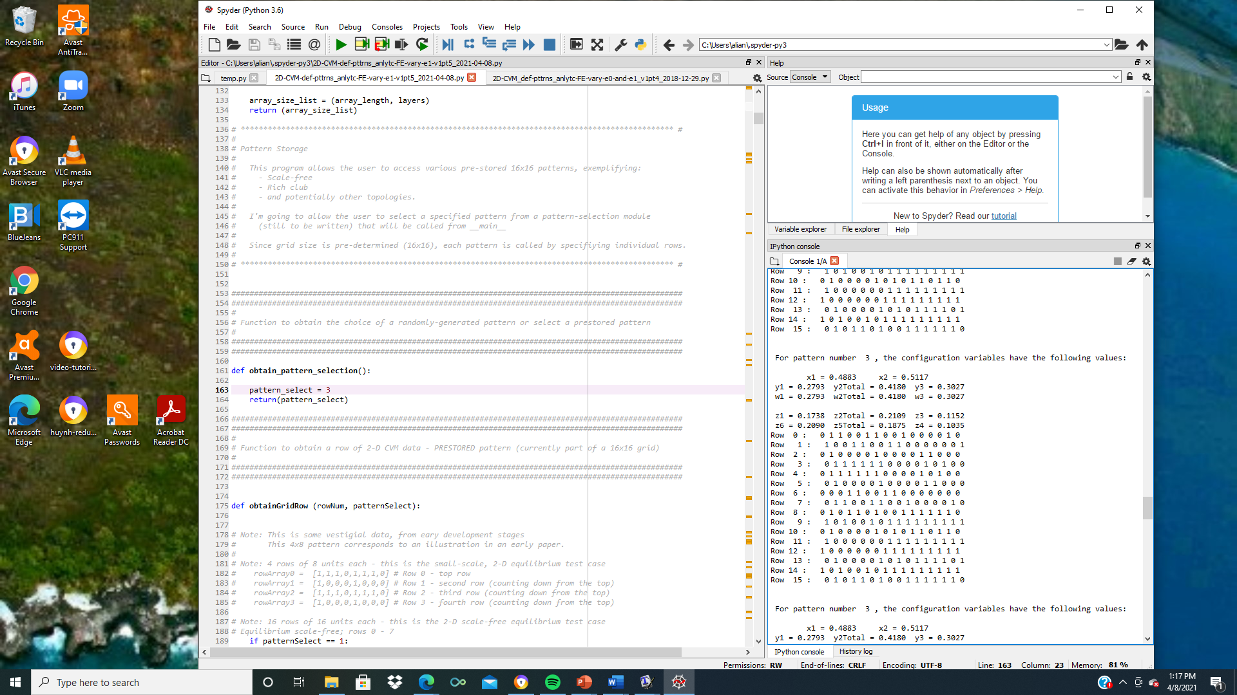
Natural Topography #3
Version (a)
Row 15*
*wrap-around
Natural Topography #3: High Dispersion
Row 0
Row 1
Row 2
Row 3
Row 4
Row 5
Row 6
Row 7
Row 8
Row 9
Row 10
Row 11
Row 12
Row 13
Row 14
Row 15

Slide 32
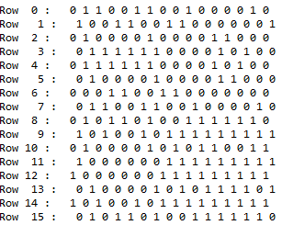
Natural Topography #3
Version (a)
Row 15*
*wrap-around
Natural Topography #3: High Dispersion
Row 0
Row 1
Row 2
Row 3
Row 4
Row 5
Row 6
Row 7
Row 8
Row 9
Row 10
Row 11
Row 12
Row 13
Row 14
Row 15

Slide 33
We Can Obtain Analytic Results for Certain Cases
Natural Topography #3
Version (a)
Analytic Values for Configuration Variables y₂, z₁, and z₃
Case where activation enthalpy : x₁ = x₂ = 0.5
$${ ε}_{0}=0$$
B
A
A
y₂
Z₃:
Z₁:
y₂:
B
B
A
A
A
A
A
z₁
y₂
z₁
z₃
Configuration variable
h = 1 (ε₁ = 0)
Nat. Top. #3:
z₃
y₂ = 0.418/2
= 0.209
z₁ = 0.174
z₃ = 0.115
h: interaction enthalpy parameter;
$${ h=exp(2ε}_{1})$$

Slide 34
Natural Topography #3
Version (a)
Results from Using the Program to Compute the Configuration Variables:
2D-CVM-def-pttrns_anlytc-FE-vary-e1-v1pt5_2021-04-08.py
Used Pattern 3 for this trial.

Slide 35
Natural Topography #3
Version (b)
rocks-5_2020-11-16.jpg
Version (b) tried a full-size grid, which was four of the 8x8 grids, aligned to make a 16x16 grid. The grid was shrunk very slightly so that four of these grids would fit over the topography image.

Slide 36
Natural Topography #3
Version (b)
Using four of the 8x8 grid overlays to create a 16x16 grid
Row 15*
*wrap-around
Natural Topography #3: High Dispersion
Numbers of Black Nodes
Row 0
Row 0: 8 (6,2)
Row 1
Row 1: 8 (4,4)
Row 2
Row 2: 7 (3,4)
Numbers of Black Nodes
Summary:
Row 3
Row 3: 5 (2,3)
Row 4
Row 4: 5 (3,2)
Top Half: 61 (33, 28)
Bottom Half: 67 (30, 37)
Row 5
Row 5: 9 (4,5)
Row 6
Row 6: 10 (6,4)
Row 7
Row 7: 9 (5,4)
Row 8
Row 8: 7 (3,4)
Row 9
Row 9: 8 (3,5)
Row 10
Row 10: 7 (4,3)
Row 11
Row 11: 11 (6,5)
Row 12
Row 12: 9 (3,6)
Row 13
Row 13: 5 (3,2)
Row 14
Row 14: 8 (4,4)
Row 15
Row 15: 12 (4,8)

Slide 37
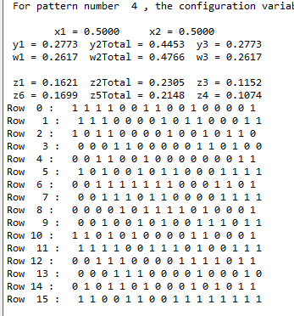
Natural Topography #3
Version (b)
Results from Using the Program to Compute the Configuration Variables:
2D-CVM-def-pttrns_anlytc-FE-vary-e1-v1pt5_2021-04-08.py
Used Pattern 4 for this trial.
Select Configuration Variables:
z1: 0.1621
z3: 0.1152
y2: 0.445/2 = 0.223

Slide 38
We Can Obtain Analytic Results for Certain Cases
Natural Topography #3
Version (b)
Analytic Values for Configuration Variables y₂, z₁, and z₃
Case where activation enthalpy : x₁ = x₂ = 0.5
$${ ε}_{0}=0$$
B
A
A
y₂
Z₃:
Z₁:
y₂:
B
B
A
A
A
A
A
z₁
y₂
z₁
z₃
Configuration variable
h = 1 (ε₁ = 0)
Nat. Top. #3:
z₃
y₂ = 0.445/2
= 0.223
z₁ = 0.162
z₃ = 0.115
h: interaction enthalpy parameter;
$${ h=exp(2ε}_{1})$$

Slide 39
Configuration Variable Values and Likely h-value Range for Pattern #3
Step 7: Visually estimate a range of potential h-values that might conceivably yield topographies that would be considered “best matches” to the initial natural topography.
This range of h-values will be used to run the program again, stepwise, through the various h-values and to obtain resulting free energy-minimized topographies, with their configuration values.
A reasonable test range for “best” h-values would be 1.05 < h-value < 1.15. (See placement of configuration variable values on analytic graph.)
The configuration variable value z₁ corresponds to an h-value of approximately 1.15, whereas the z₃ value corresponds to an h-value of approximately 1.05. The configuration variable y₂ value is in the middle, although closer to the 1.15 corresponding to z₁.

Slide 40
Natural Topography #3:
Initial Interpretations of Configuration Variable Values and Corresponding h-values
Configuration variable z₁: A-A-A triplets (black-black-black): This triplet value is relatively small, indicating that there are not many contiguous black-black-black areas; this is to be expected since this topography is the one that is most dispersed. This particular configuration variable value corresponds to a lower h-value than we are observing as correspondence for the other two configuration variables. We see very little in the way of solid black masses in the topography. This z₁ value is very close to what we would expect if there were no between-unit interactions.
Configuration variable z₃: A-B-A triplets (black-white-black): This value is approximately in line with the h-value associated with the y₂ (A-B and B-A pairs) value. This value is also relatively low overall; z₃ values are generally created by “rivers” of white (B) nodes in a mass of black, or by “peninsulas” or “connecting diagonals” of black in a sea of white. This means that we do not have a preponderance of thin, narrow rivers or peninsulas.
Configuration variable y₂: A-B and B-A pairs (black-white and white-black): The y₂ value indicates unlike pairs, which means a boundary. This value is – relatively – low. It indicates some between-unit interactions, but not strong enough to create large masses as we saw in Nat. Top. #1.

Slide 41
Configuration Variable Values and Corresponding h-values
Pattern | z₁ | z₃ | y₂ | h-value (low) | h-value (high)
1 | 0.3145 | 0.0645 | 0.125 | 1.45 | 1.55
2 | - | - | - | - | -
3 | 0.1621 | 0.1152 | 0.223 | 1.05 | 1.15

